Slide 1
BSEN 5250/6250
Lecture 11
Temperature and Biological Activity
Reading: Chapter 12 of Computer Simulation in Biology by
Keen and Spain

Slide 2
Introduction
Temperature is a primary driving variable for many biological processes
- affects chemical reaction rates
- enzyme kinetics
- growth and development rtes
- efficiency of energy conversion

Slide 3
Definition of Temperature
Temperature is a measure of heat content
Common heat or energy units are Joule, MJ, W/m², calorie,
BTU, therm, watt-hr

Slide 4
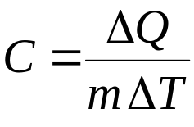
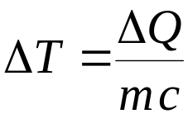
Heat Capacity
Specific heat capacity (c) is the amount of heat needed to raise a gram of substance 1ºC
c = specific heat capacity, cal/g-C
ΔQ = change in energy, cal
ΔT = change in temperature, C
m = mass, g
Which can be rearranged to solve for temperature change of an object resulting from addition of energy

Slide 5
Helpful Characteristics
Specific heat of water is
4.19 J/gºC
4190 J/kgºC
1.0 cal/gºC
1.0 BTU/lbºF
Density of water is 1 g/cm³ or 62.43 lb/ft³

Slide 6
How to Compute Temperature Rise
Given: 1 cm³ of water at 4ºC
T=4ºC
Find: A) Energy at 4ºC
B) Temperature if you add 10 calories of energy

Slide 7

How to Compute Temperature Rise
Solution: At 4 C, the energy content can be computed by
c = specific heat capacity, cal/g-C
ΔQ = change in energy, cal
ΔT = change in temperature, C
m = mass, g
Q = 1 cal/gºC * (1 cm³ * 1 g/cm³) * 4ºC
Q = 4 calories of energy
T=4ºC

Slide 8
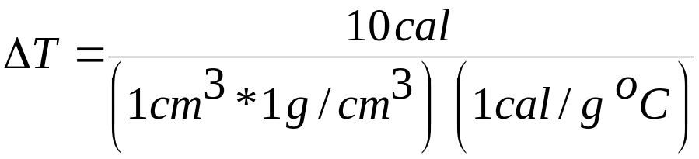

How to Compute Temperature Rise
Solution: If you add 10 calories, the temperature can be computed by
c = specific heat capacity, cal/g-C
dQ = change in energy, cal
dT = change in temperature, C
m = mass, g
New Temperature = 4 + 10 = 14ºC
T=4ºC

Slide 9
Model of Temperature in A Stratifying Lake
Water temperature has a large impact on biological activity and nutrient cycles. Water temperature is distributed over space. We can simulate water temperature distribution by dividing the water body into layers and computing the heat flow into and out of each layer
If we are not concerned with temperature distribution in the xy-plane, we can represent the z dimension as a distributed column with each layer representing a unit volume
T= 4C
T= 4C
T= 4C
T= 4C
T= 4C

Slide 10
Model of Temperature in A Stratifying Lake
Given: A 30 m deep lake has a vertical temperature distribution of 4 C and receives 350 cal/cm²/day of energy from the sun
350 cal/cm²/d
T1 = 4C
1 m depth
T2= 4C
….
T29= 4C
T30= 4C

Slide 11
Model of Temperature in A Stratifying Lake
Find: Compute the temperature in each 1-m layer over 30 days
T1 = 4C
1 m depth
T2= 4C
….
T29= 4C
T30= 4C

Slide 12
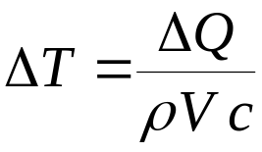
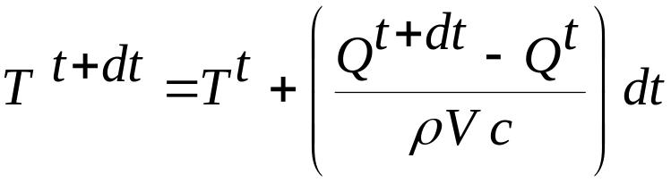
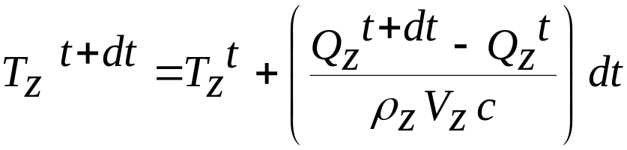
Model of Temperature in A Stratifying Lake
Governing Equation
or
Euler’s form of solution
General form for each layer z

Slide 13
Model of Temperature in A Stratifying Lake
At Surface, z=0
Q₀
Q₀ = S – O - E
Z=1
Q₀ = heat transferred from layer 1 to atmosphere, cal/cm²
S = sensible heat exchange (cond & conv), cal/cm²
O = radiation heat transfer to atmosphere, cal/cm²
E = heat transfer due to evaporation and condensation, cal/cm²

Slide 14
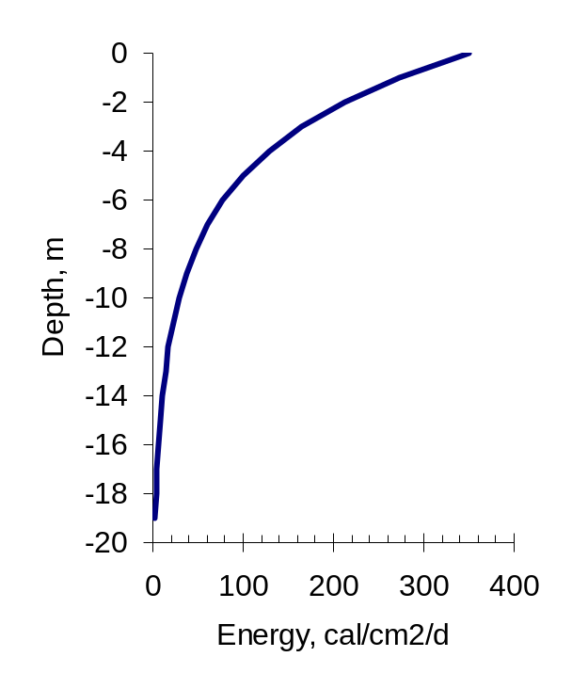
Model of Temperature in A Stratifying Lake
For All Other Layers
energy absorbed from light (I_{a})
Q₁₂
Z=1
Z=2
Q₂₃
Z=3
Q₃₄
Z=4

Slide 15
Model of Temperature in A Stratifying Lake
Energy balances in water bodies is extremely complex. This example in your text assumes the following:
Spring warmup conditions
Heat flows only in a downward direction
The assumptions made in this example do not work for summer, fall or winter conditions

Slide 16
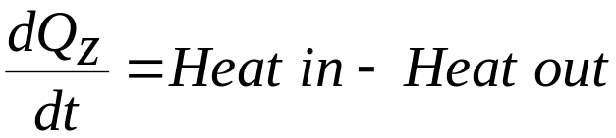
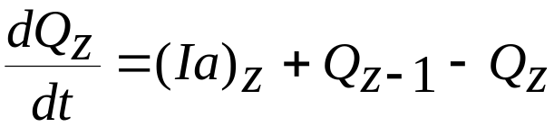
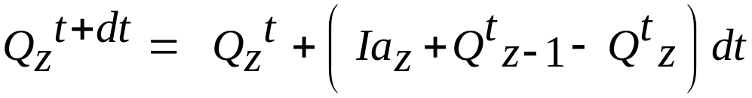
Model of Temperature in A Stratifying Lake
Energy Balance for Each Layer

Slide 17
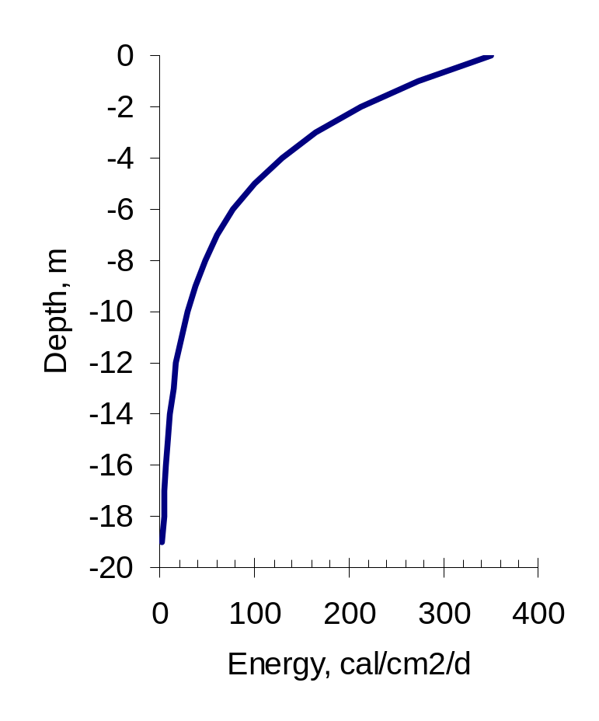
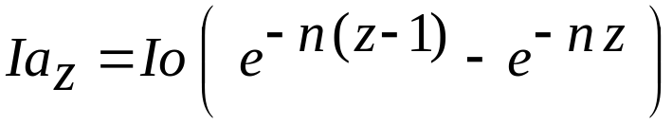
Model of Temperature in A Stratifying Lake
Energy From Light Absorption
Ia_{z} = I_{z} – I_{z+1}
Ia₁
Ia₂
Where
Ia_{z} = energy absorbed at depth z, cal/cm²/day
Io = incoming light energy at top of water, cal/cm²/d
n = absorption coefficient, 1/m
z = depth, m

Slide 18
Model of Temperature in A Stratifying Lake
Heat Flow Between Layers
Q_{z} = F A_{z} (T_{z} – T_{z+1})
Q_{z} = heat flow from layer z, cal/cm²/day
F = proportionality constant, 1/ºC-d
A_{z} = eddy diffusivity coefficient, cal/cm²
T = temperature, C

Slide 19
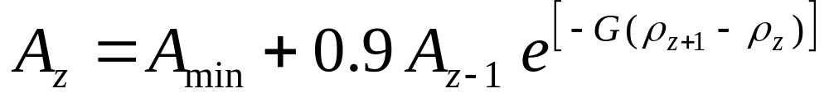
Model of Temperature in A Stratifying Lake
Heat Flow Between Layers
Where
A_{min} = minimum eddy diffusivity, 0.1 cal/cm²
G = constant
p_{z} = density of water, g/cm³
p_{z} = 0.999884 + (5.75x10⁻⁵) T_{z} – (7.27x10⁻⁶) T_{z}²

Slide 20
Model of Temperature in A Stratifying Lake
Exercise 12-9 in Your Text
Io = 350 cal/cm²/d
A0 – 0.5 cal/cm²
O = -20 cal/cm²/d
E = 70 cal/cm²/d
S = 30 cal/cm²/d
N = 0.4
F = 100
G = 2000
Assumptions
All temperatures = 4 C
Temp. of soil layer (z=21) is same as bottom of lake at z=20
Assume density of soil is 1.5 g/cm³

Slide 21
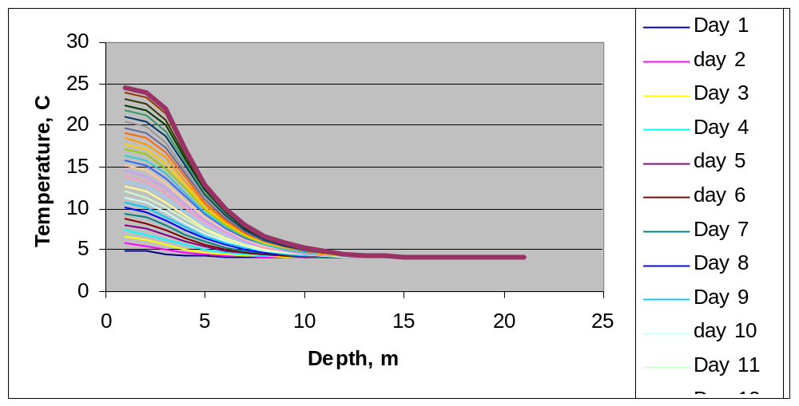
Temperature Over time

Slide 22
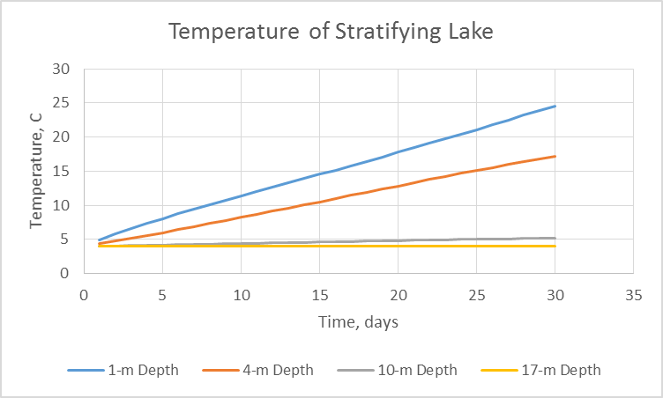
Lake Temperature Over time
Temperature continues to increase in a linear fashion because model assumes constant Qo characteristics at the surface and does not adequately account for heat transfer at interface

Slide 23
Temperature Effects on Development
Growth – increase in size, mass, volume, etc
Development – increase in maturity or progress through the life cycle (emergence, leaf addition, flowering, pods, seeds, maturity)

Slide 24
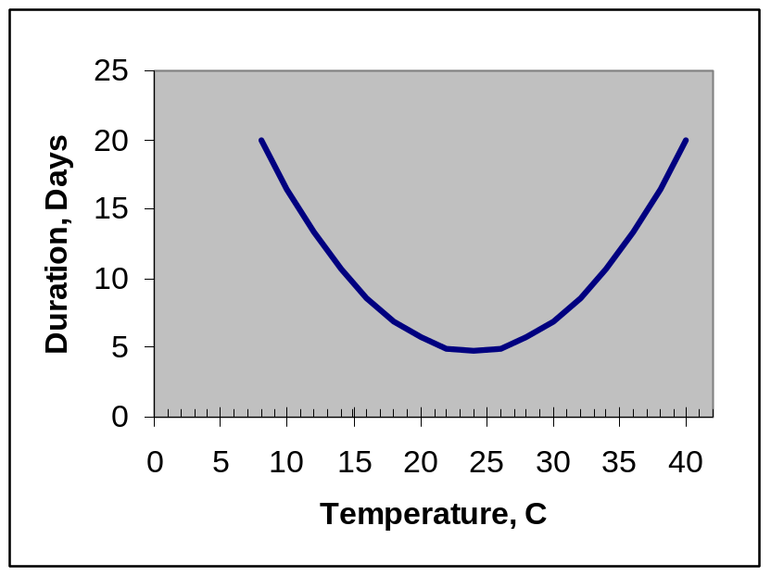
Temperature Effects on Development
Duration from egg formation to hatching is strong function of temperature. There is an optimum temperature that results in a minimum duration of days to hatching. Both high and low temperatures can increase time to hatching

Slide 25
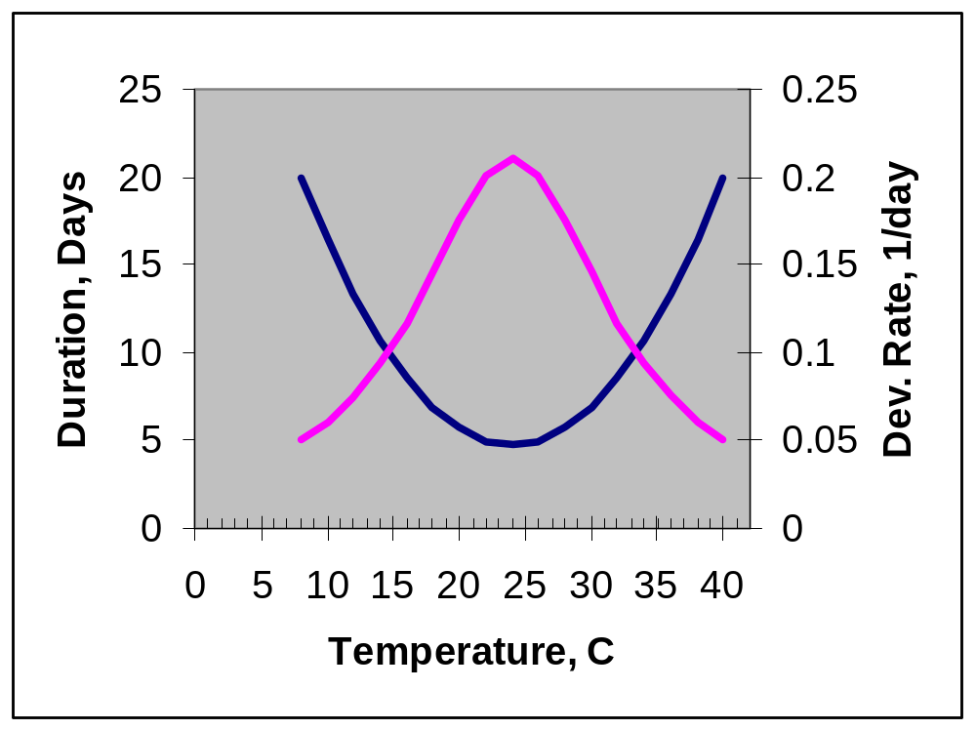
Temperature Effects on Development
Rate of Development = 1/duration

Slide 26
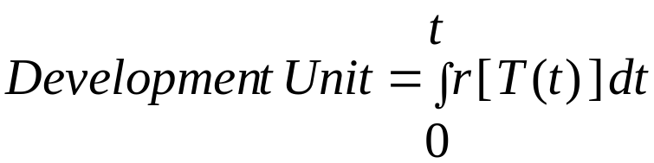
Rate Summation Techniques
Where
t = time
T(t) = temperature at time t, ºC
r[T(t)] = development rate for temperature t at time t, 1/time
When D.U = 1.0, development is completed

Slide 27
Exercise 12-8
Laboratory observations conducted at 10 ºC and 20 ºC identified the following relationships in hatching a particular insect egg
Const. Temp. Duration Rate (1/dur)
10 ºC 100 hrs 0.01/hr
20 ºC 33.3 hrs 0.03/hr

Slide 28
Exercise 12-8
Suppose eggs are laid and exposed to the following temperature regime.
Time Dev. Development Sum of
Period Rate/hr Units D.U.’s Total hrs
12 hrs @ 10C .01 .12 .12 12
12 hrs @ 20C .03 .36 .48 24
12 hrs @ 10C .01 .12 .60 36
12 hrs @ 20C .03 .36 .96 48
4 hrs @ 10C .01 .04 1.00 52
When the sum of the development units = 1.0, hatching occurs

Slide 29
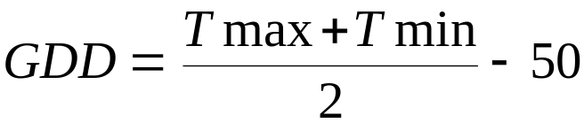
Corn Development
Development rate is often measured in growing degree days (GDD) in agronomic crops.
r_{max}
Tmax, Tmin units ºF
If GDD < 0 then GDD = 0
If GDD > 36 then GDD = 36
50
86
Corn hybrids require approximately 1300 GDD’s (base 50F) to silk and between 2400-2600 GDD’s base 50F to mature
Avg. Temp, F

Slide 30
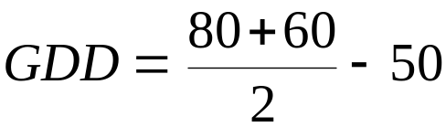
Corn Development
Example: The maximum and minimum temperature today is 80F and 60F, respectively. How many GDD’s occurred today?
GDD = 20 ºF-days

Slide 31
Corn Development
You can compute the GDD’s each day during the season to track crop development patterns
Day Tmax Tmin GDD’s
5/1 70 40 5.0
5/2 75 50 12.5
5/3 80 50 15.0
5/4 72 48 10
…
…
…
10/20 60 32 0

